Slide 1

Team minerva’s project for hackathon Theme : healthtech
By:-
Kshitij Nikum,Harshit Nigam,Srishti Tirkey,Shubham Pawar

Slide 2
Key challenges of on-premise data storage in healthcare
NEED FOR LARGER INFRASTRUCTURE :-
As the amount of healthcare data to be stored and managed escalates, it demands more and more physical storage space. When hospitals and healthcare centers opt for on-premise data storage, they have to arrange for physical space within the premises to host the servers. While it offers the convenience of having the data within reach, in larger cities, the cost of acquiring this physical space is humongous. As more and more patients are added, more storage space is required
LACK OF SECURITY :-
As of now many healthcare centres use the method of maintaining paper files when it comes to storing data about patients. This method lacks security and the the files can easily be lost bringing trouble to the patient and the healthcare centre.

Slide 3

CUMBERSOME :-
Keeping track of the data and information of a large number of patients in files is cumbersome and tiring when done on papers.
NO BACKUP :-
If a person’s data is lost or damaged by accident, there’s no option for a backup which could be otherwise be possible in online data storage system.

Slide 4

To overcome these problems we came up with the project:

Slide 5
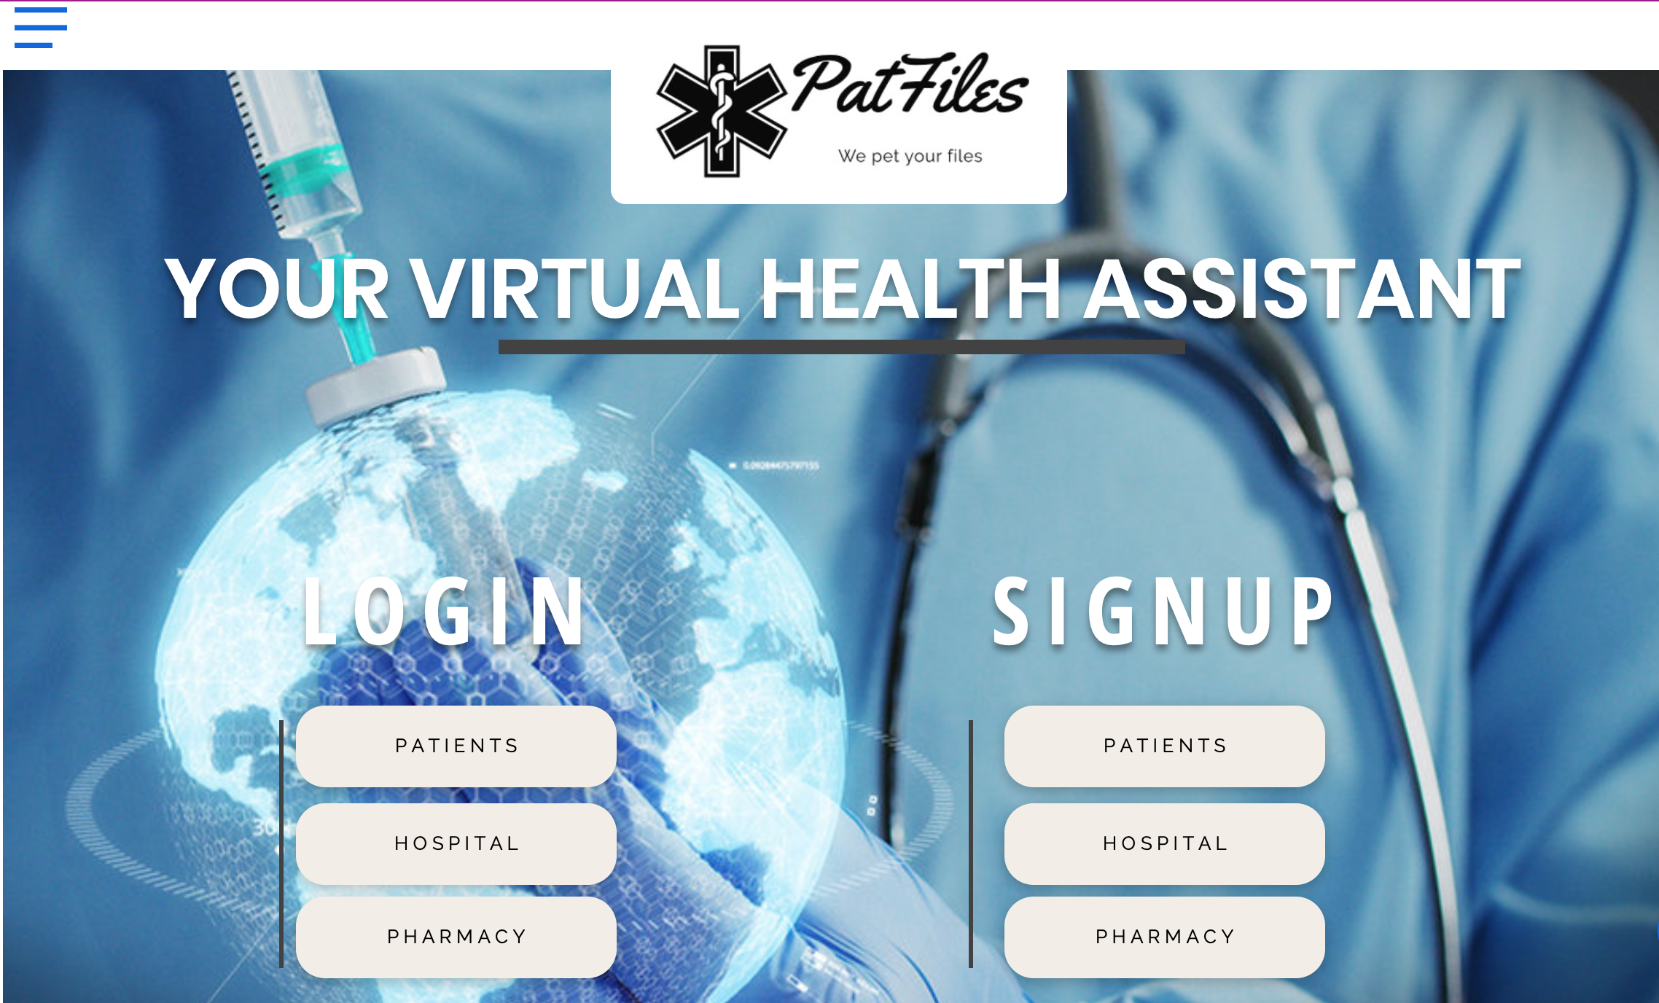
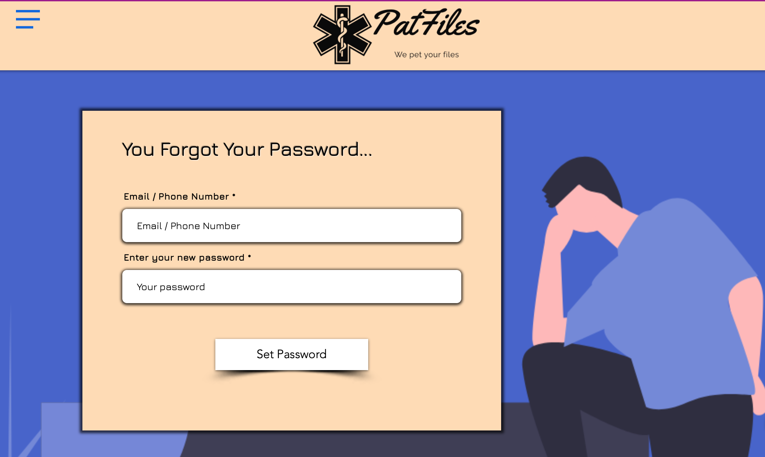
THIS IS THE HOMEPAGE OF THE WEBSITE
SEPARATE LOGIN AND SIGNUP PAGES FOR PATIENTS,HOSPITAL AND PHARMACY.
(‘FORGET PASSWORD’ PAGE)
(HOME PAGE)
The user will be directed to this page in case they forget their password.
The user needs to enter their email or phone number to change their password

Slide 6
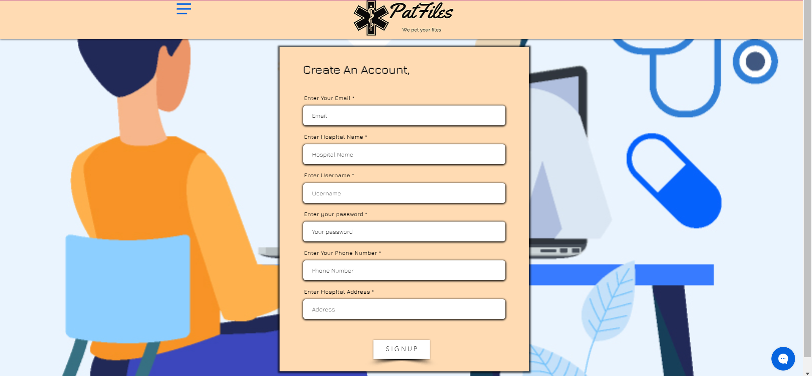
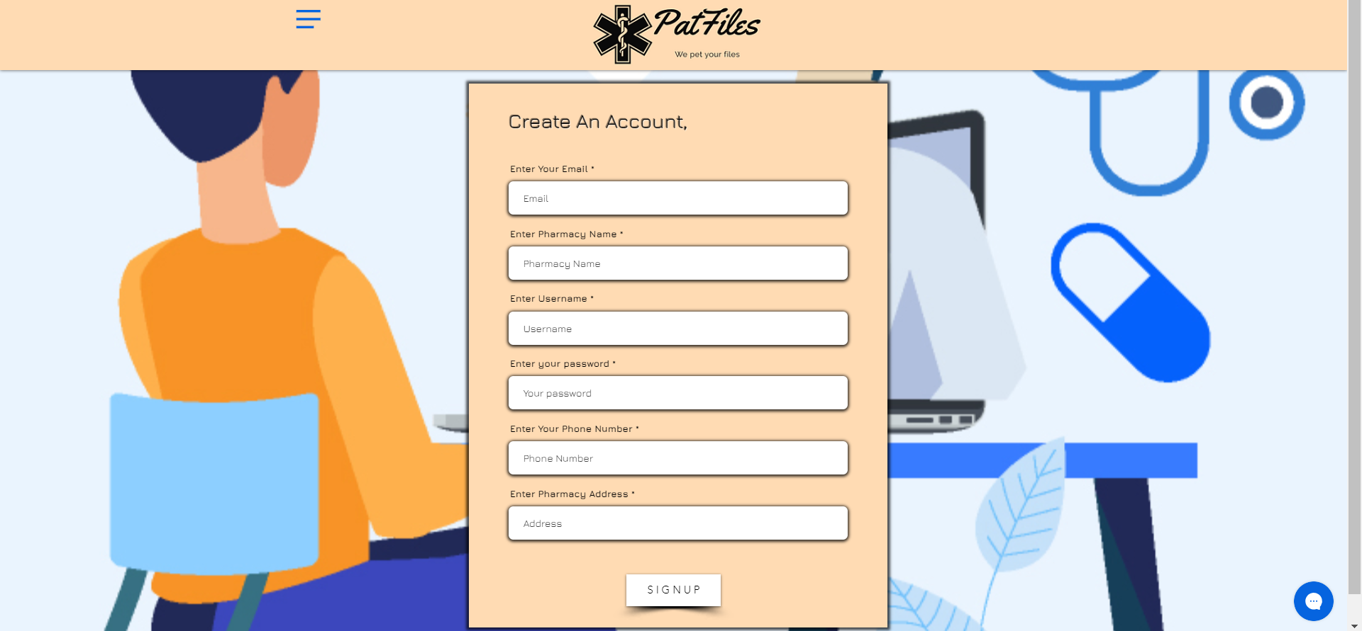
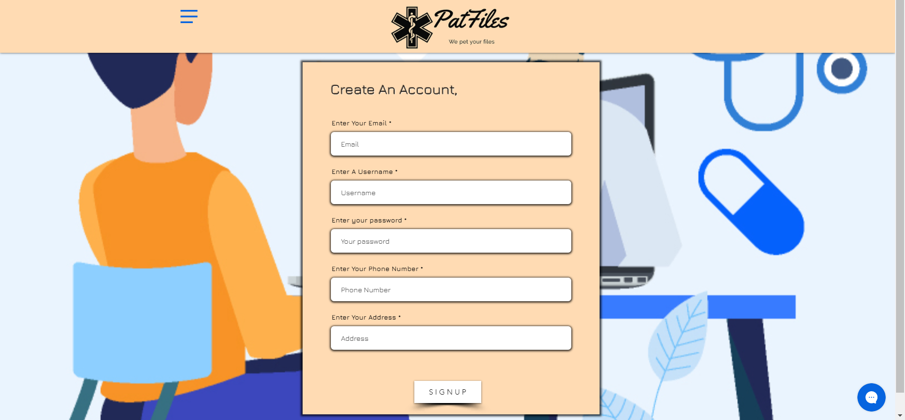
When the pharmacy and hospital creates an account ,the additional entry they need to make is of their pharmacy name and its location. Here the username will be used to distinguish between different doctors and pharmacists
(HOSPITAL’S SIGN UP PAGE)
when the patient creates an account ,they’ll need to enter their emails ,username, a password phone number and their address
(Pharmacy’s sign up page)
(client’s sign up page)

Slide 7
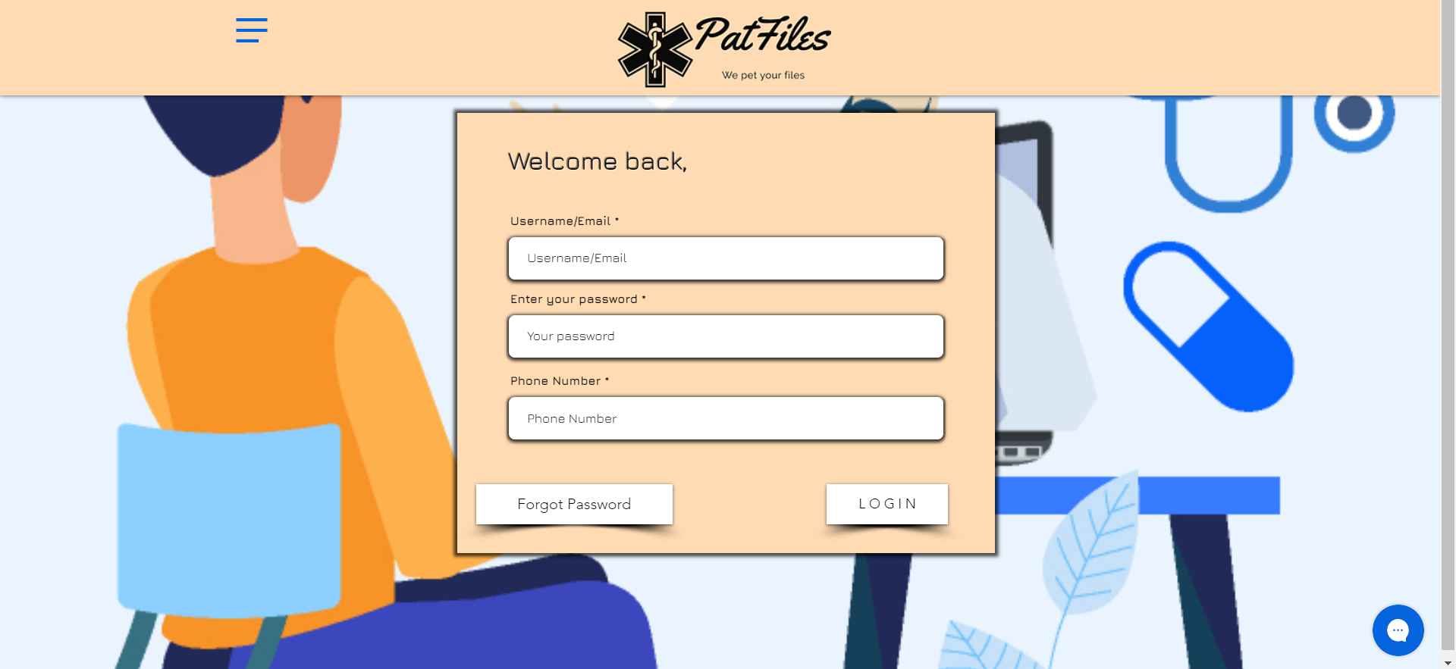
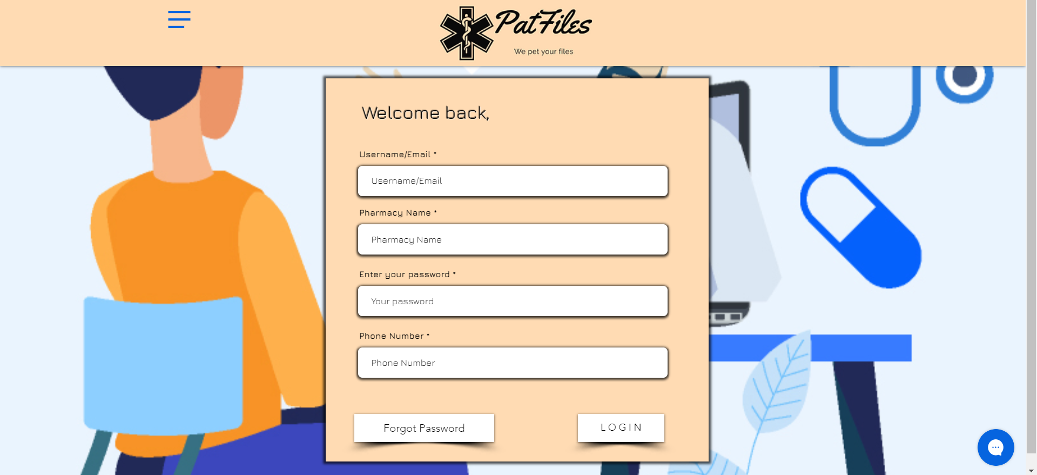
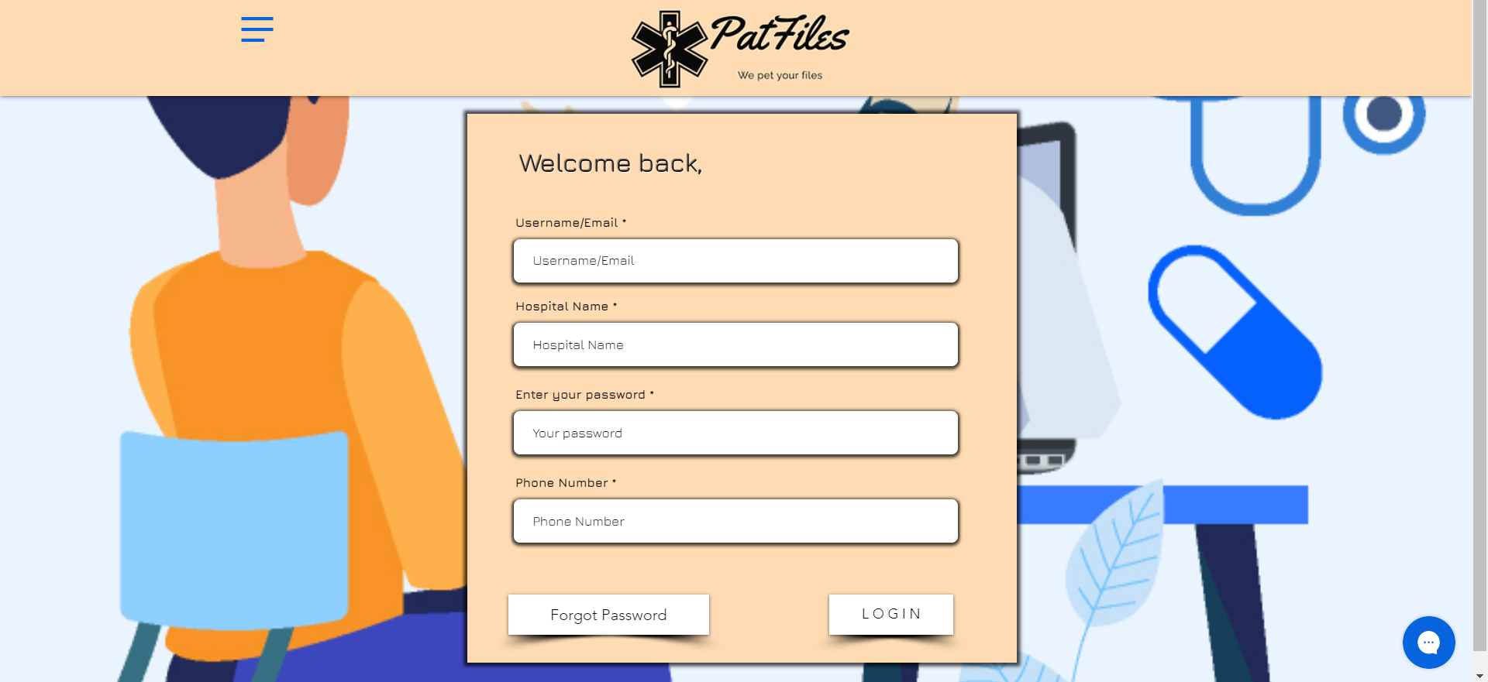
There are separate log in pages depending on who is logging in.
the common entry will be username, password and phone number asked in all the log in pages.
if In case the user forgets their password they can click on the “forget password” button to change it.
in case of pharmacy log in page the additional entry will be pharmacy name
(client’s log in page)
(pharmacy’s log in page)
in case of the hospital log in page the addition entry will be the hospital name
(hospital’s log in page)

Slide 8
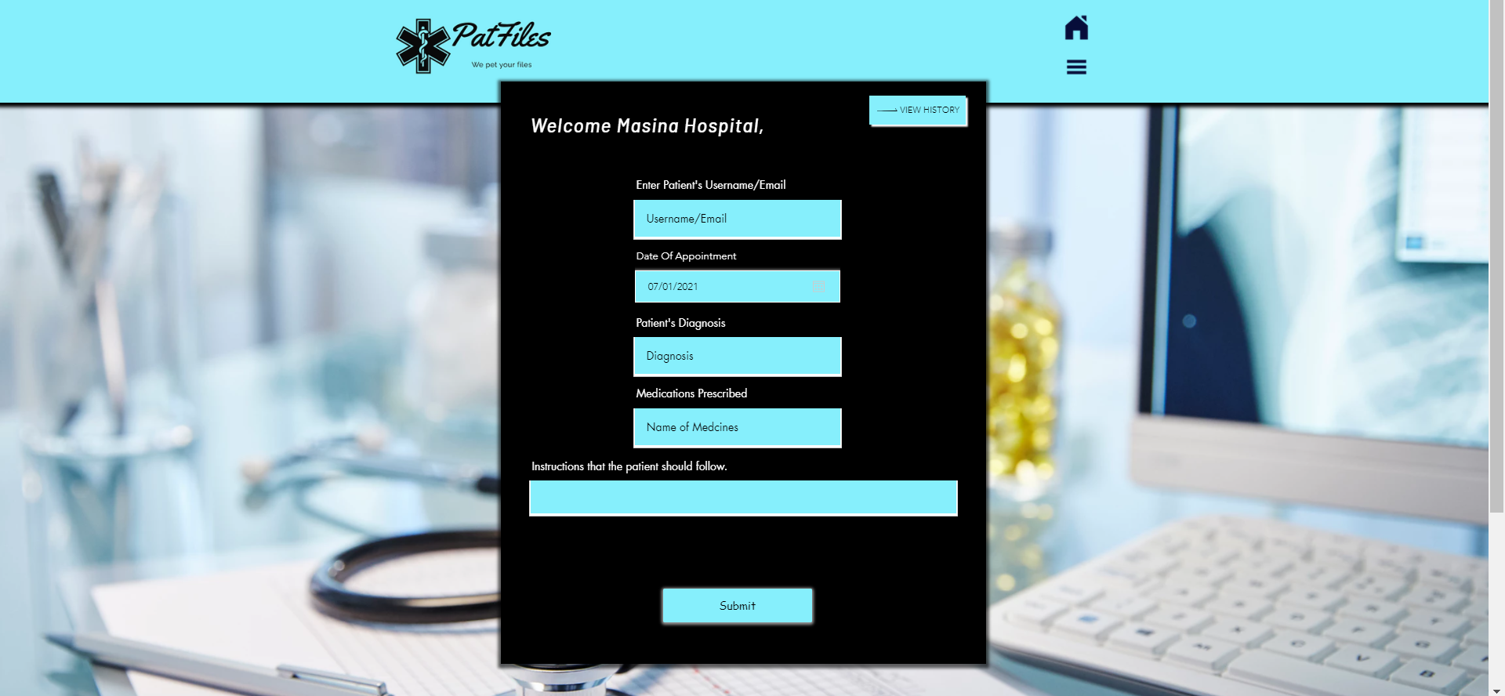
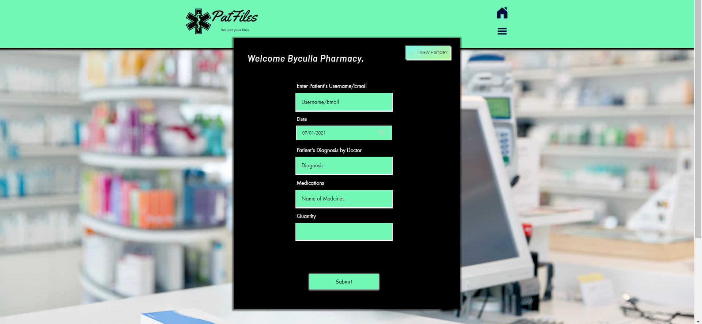
the view history button present in hospital and pharmacy homepage is used to keep a track of the patients seen and treated.
the hospital homepage will keep a track of the patients seen by a doctor, the most diagnosed Illness, most prescribed medicines.
respective names of the hospital and pharmacy will be displayed next to the “welcome” in both the homepages.
(hospital’s homepage)
the pharmacy homepage will keep a track of the customers attended , most sold medicines, and most diagnosed illness in that area and also the quantity of medicines sold to that customer.
(pharmacy’s homepage)

Slide 9
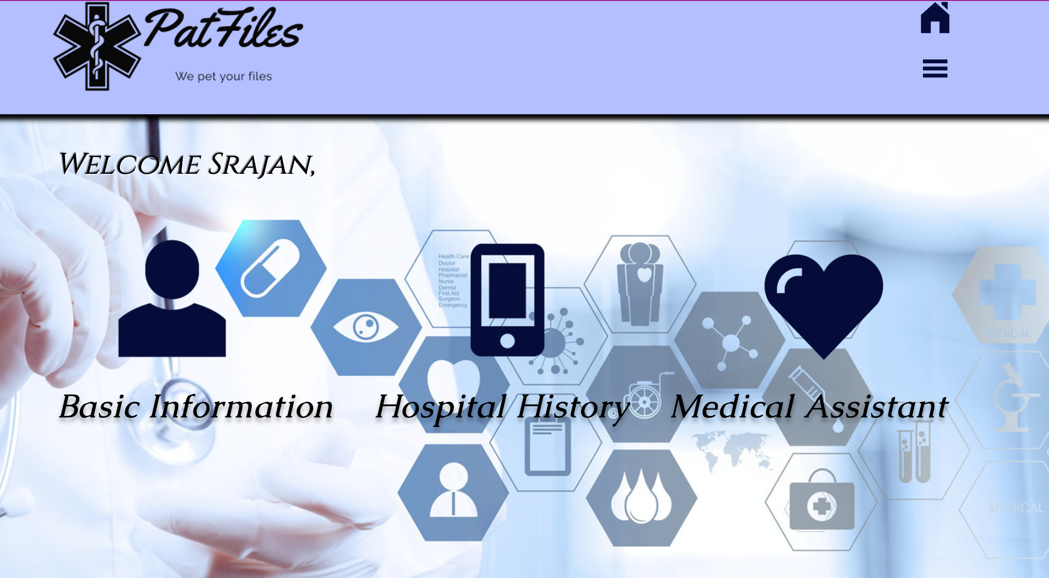

this is the patient’s homepage
the basic information button will direct the patient to the basic information page, the hospital history button will show the hospitals visited by the patient, the medical assistant button will lead to the medical assistant page.
respective names of the user will be displayed next to the “welcome”.
below few informative paragraphs on few medical branches are present for the patient to read and get more knowledge and understanding.
(client’s homepage)

Slide 10
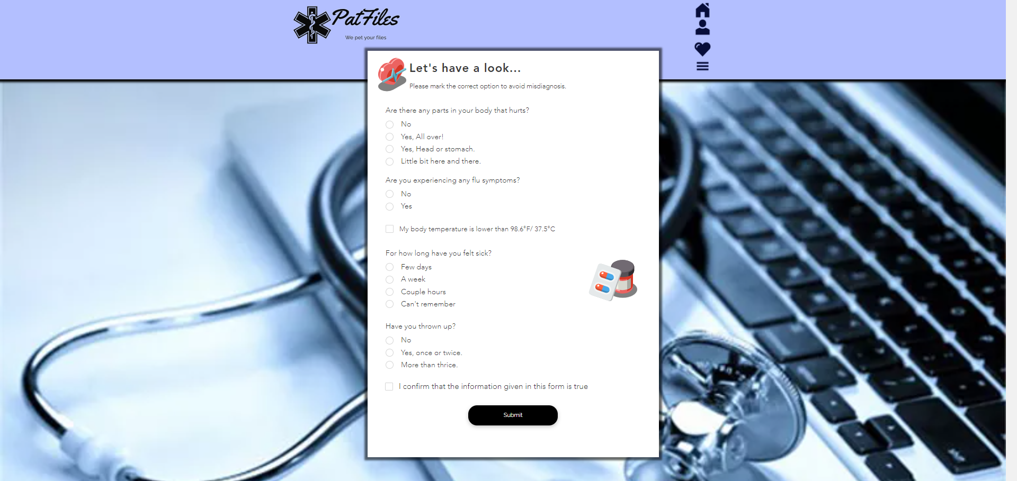
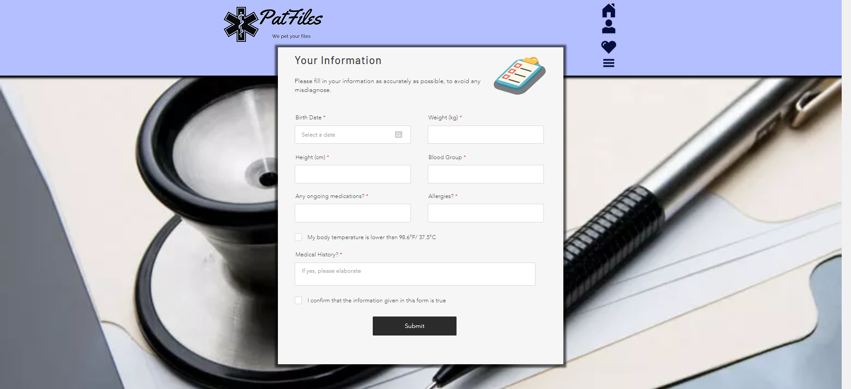
the medical assistant page will help the patient to get a rough idea what the possible illness might be based on their symptoms. This can be used as a reference by the doctor when visiting.
Medical assistant page will also provide few home remedies to ease some symptoms based on the illness predicted by it.
(medical assistance page)
the basic information page is where the basic details about the patients health will be asked and stored for the doctor to refer when diagnosing and if required by the pharmacist then to have a look before giving the medicines.
these pages will save the need to carry around files, save time and make it easier to save patient records.
(basic information page)

Slide 11
Our model
The patients’ info will be directly made available to the doctors/pharmacy
Cloud Based Data storage
Analyze patient’s as well as doctor’s activity
Separate portals for patients as well as hospitals

Slide 12
What’s our plan?
Create a framework which is flexible and future ready
Create an advanced diagnosis AI.
Expand implementation nationally or even internationally

Slide 13

Why patfiles?
Questions asked would be simple and elaborative for patients’ understanding and Ease of access.
Users will be able to access the site in a language they prefer.
Easily accessible database which will prevent the patient from getting the wrong prescription.
The database will act as a survey to get an overview of common illnesses, ages and areas affected the most.
Direct communication with the physician and an option to have a virtual visit.
Advanced assistant which will instantly suggest possible illness and treatment based on the symptoms.

Slide 14


